Slide 1

Subjective Methods of Measuring QoE
Mikołaj Leszczuk, Jakub Nawała
25.10.2020
Notes:
This is what we are doing on a daily basis.
Again, we will be focusing on video-related applications.
So how do you measure people’s preferences and expectations?

Slide 2


Quality of Experience (QoE)
The degree of delight or annoyance of a person
The person experiences an application, service, or system
The QoE results from the fulfillment of the person’s expectations and needs wrt utility and/or enjoyment
All that in the light of person’s context, personality and current state
Adapted from Möller, S., & Raake, A. (Eds.). (2014). Quality of Experience. https://doi.org/10.1007/978-3-319-02681-7
Notes:
wrt = with respect to
User-centric approach
Relative to the current user’s expectations
Strongly connected with the way we perceive the world

Slide 3
From QoS to QoE
QoS
Quality model
QoE
Pixels
Calibra- tion
What we know
What we build
What we want
Notes:
QoS - Quality of Service; measured in terms of lost packets, delays and bandwidth.
Everything on the left can be objectively measured.
Pixels mean here that we are analysing the content pixel-by-pixel.
This graph refers to video-related QoE.
So how do we obtain the calibration data?

Slide 4
Idea
Subjective scores (i.e. calibration data) = ground truth
Vary contents to measure the quality
Everything else should stay the same
Use the scores to improve your predictions about the quality (i.e., build a better-quality model)
Notes:
Subjective scores - so called ground truth (i.e., provided by direct observation and not coming from inference)
Controlled environment - get rid of, hopefully, all confounding factors.

Slide 5
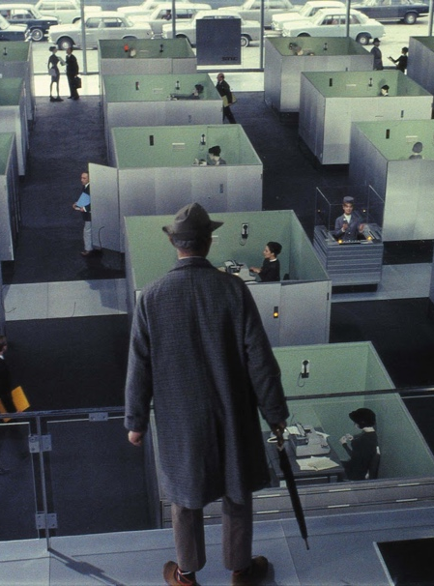
Obtaining Calibration Data
Perform a “subjective test”
Subjective scores as a result
Hundreds to thousands needed
Various contents, qualities, age groups, etc.
Homogeneous conditions for everyone
Notes:
We want the test conditions to be homogeneous to make sure this is the quality that is judged and not some other factors (like light disturbances, acoustic noise etc.).
Image on the right corresponds to how testing rooms look like. They are usually small and contain as small number of distractions as possible.
Technicalities about subjective testing follow...

Slide 6
Naming Convention
Sources (SRC)
Hypothetical Reference Circuits (HRC)
Processed Video Sequences (PVS)
Mean Opinion Scores (MOS)
Notes:
Explain the terms
HRC = content degradation condition
I need students to understand it so I can explain other things more briefly.

Slide 7
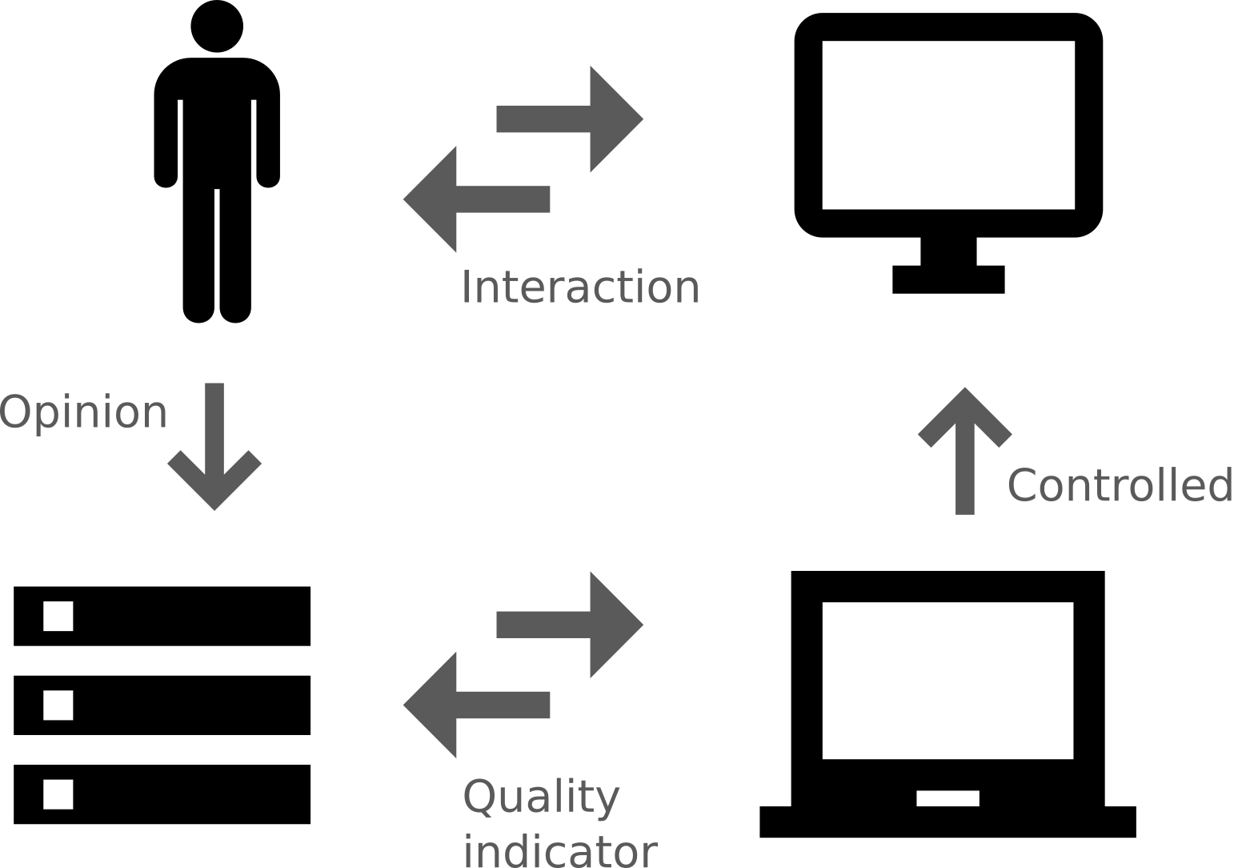
Practical Realization
Notes:
Start from the top left.
You are going to (or have already) experience(d) this setup today. :)

Slide 8


Content is Important
Different expectations from different contents
Examples:
Sport,
News,
Cartoon.
Try to accomodate for the whole scale of qualities
Images taken from the VQEG’s Report on the Validation of Video Quality Metrics for High Definition Video Content

Slide 9


Testers are Important
Different expectations depending on a social group
Examples:
age groups,
ethnic groups,
level of advancement groups
Notes:
The level of advancement - one can be a naive user or an expert.

Slide 10
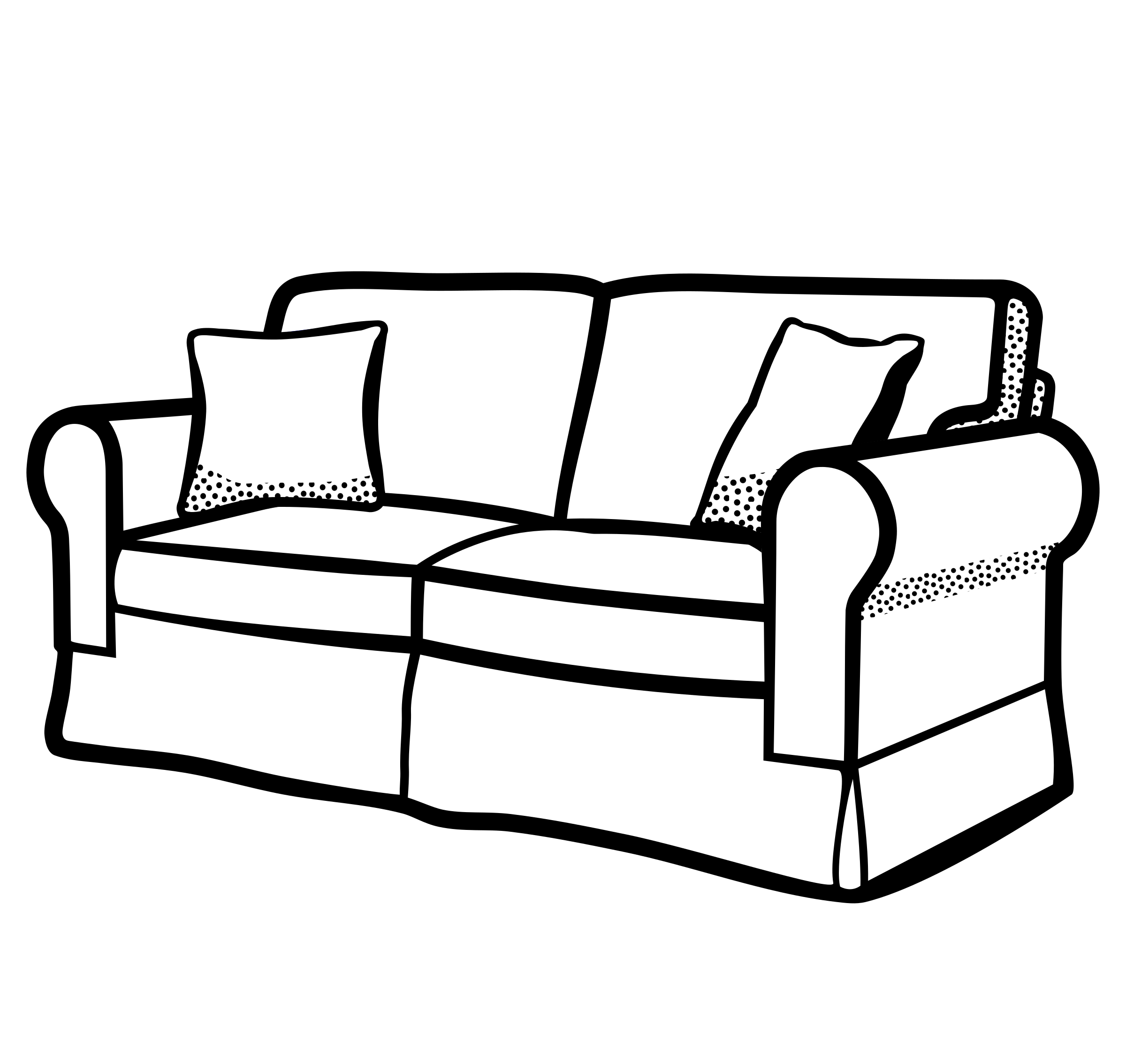
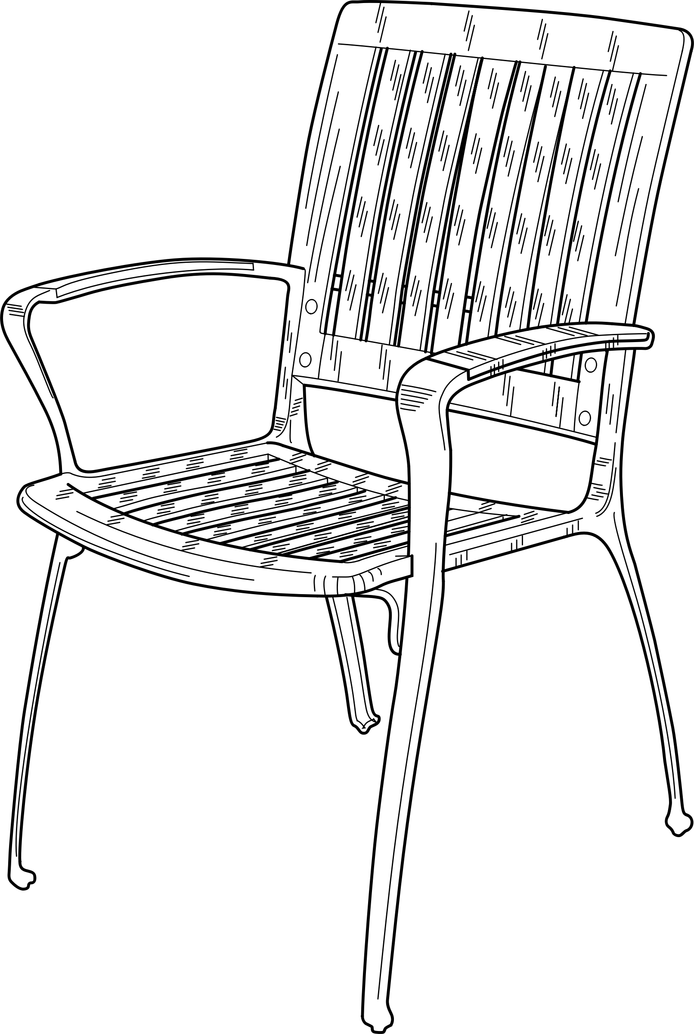
Environment is Important
Lighting conditions
Display size
Distance from the display
Is tester sitting on a chair or a sofa?
Is there anything that can distract the tester?
Notes:
Those are one of the most important factors defining whether your test can be compared with any other test.
We have a sofa in our QoE laboratory (the B9 building, 1st floor). It is good for having internal meetings as well as for testing!

Slide 11

Training is Important
We want to have the data of good quality
The tester must know how to use a testing interface
Notes:
quality data - garbage in, garbage out if the tester does not know what one is doing

Slide 12
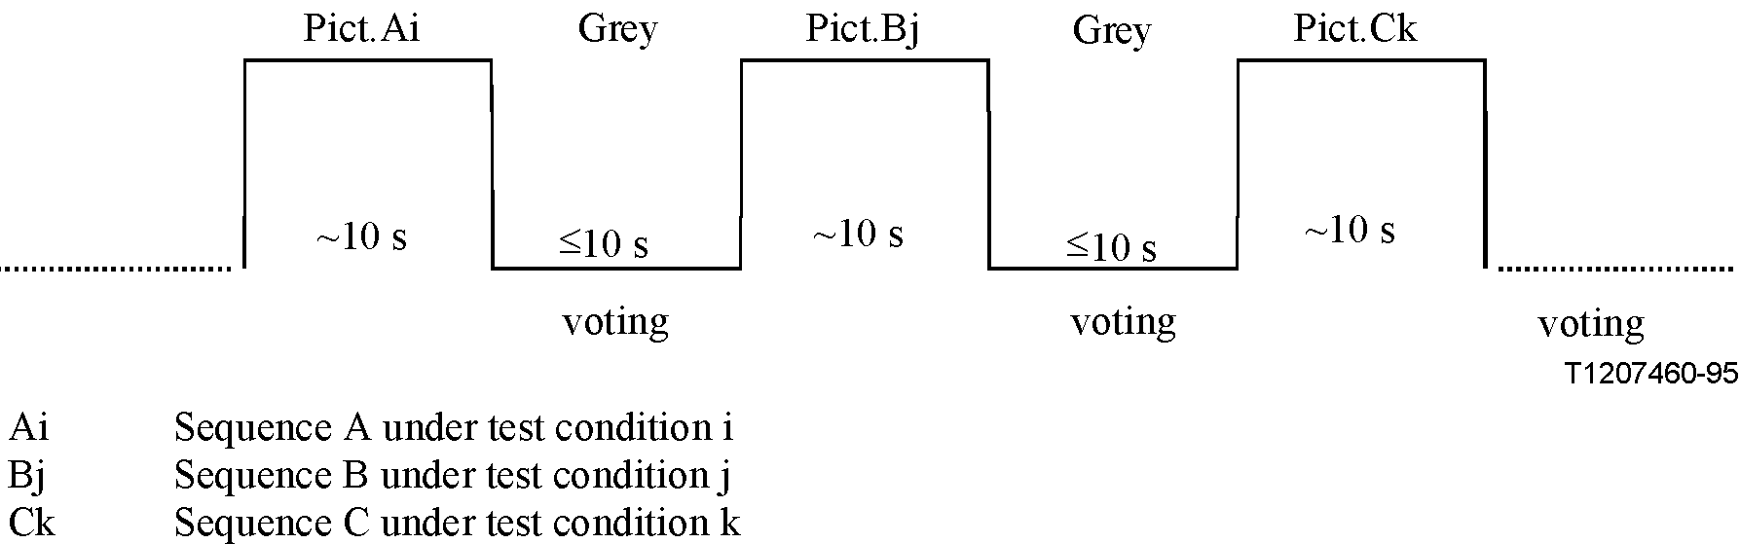
Scale is Important
How many levels of quality do we differentiate?
Do we compare PVSs or score them one-by-one?
Absolute Category Rating (ACR) as the most popular
Notes:
Mention what is the ordinal scale (and what it is not).
ACR: PVSs rated one-by-one, no explicit comparisons, labelled, ordinal scale.
Scale is tightly coupled with a method. One uses the different scale, as well as an experiment design, when a tester can compare many PVSs and different if one cannot do so.

Slide 13
Why do We Care?
We want repeatable results (that can be compared among many laboratories)

Slide 14
Let’s do the Test!
qoe.leszcz.uk
Notes:
You will have a chance to be the tester yourself.

